Slide 1
Audio based weather prediction
Jiameng Ma, Huishi Wang, SriVagdevi Viswanadha

Slide 2
Real-Time Weather Classification Using Audio Features
Motivation
Real-Time Weather Awareness
Analyze weather sounds (rain, thunder, hail) to detect and classify weather events instantly after they occur
Enhancing Smart Home Ecosystems
Integrate weather classification into smart home systems to automate responses (e.g., closing windows during rain, optimizing heating for snow).
Improved Safety and Emergency Alerts
Enable quick detection of severe weather conditions (like thunderstorms or hail) to enhance warning systems and response times.

Slide 3
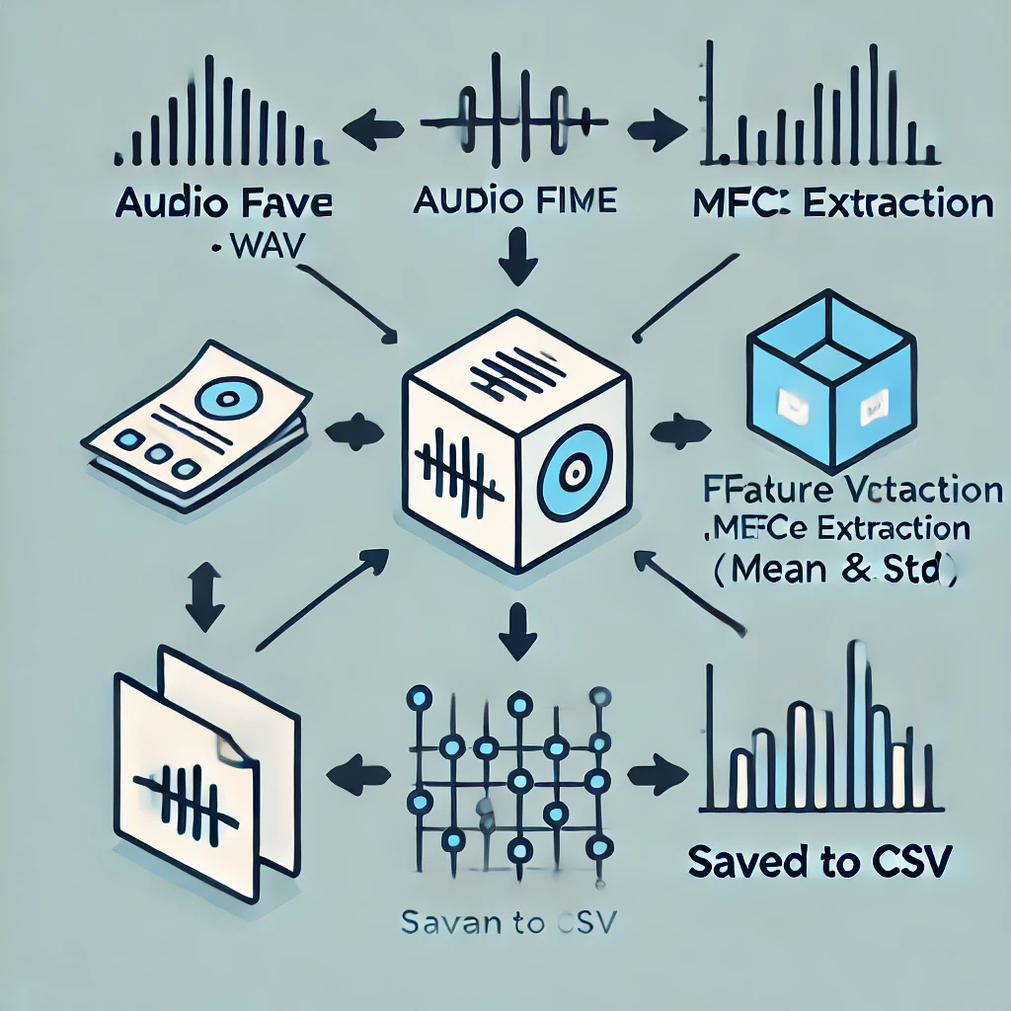
Introduction to Dataset Creation
Dataset Collection Process
Using the API tool Free Sound we downloaded the different audio files like hail , wind, rain,thunder and snow.
Consolidated these audio filenames and their corresponding labels into a CSV file with the columns of the file name and the labels.
Extracted 26-dimensional MFCC features (mean & std) from .wav audio files for classification using librosa.

Slide 4
Training Model Set up
Data Loading and Preprocessing
Loaded the dataset, separated features and target, encoded the target labels, and standardized the features for model training.
Model Training
An XGBoost classifier is trained using 5-fold Stratified K-Fold Cross-Validation with class weights and hyperparameters like n_estimators=200 and learning_rate=0.01 to handle class imbalance and optimize performance.
Model Evaluation
The model's accuracy is evaluated through cross-validation, providing a robust estimate of its generalization ability.
Model Saving
The trained model and StandardScaler are saved for future use, ensuring consistency in feature scaling and enabling model deployment.

Slide 5
XGboost introduction
A scalable and efficient machine learning algorithm for supervised learning tasks, particularly regression and classification.
Features:
Boosting Technique: Combines weak learners (decision trees) iteratively to improve performance.
Speed & Efficiency: Optimized for parallel computing and handles large datasets well.
Regularization: Prevents overfitting with built-in L1 and L2 regularization.Custom
Loss Functions: Flexible and adaptable for various problems.

Slide 6
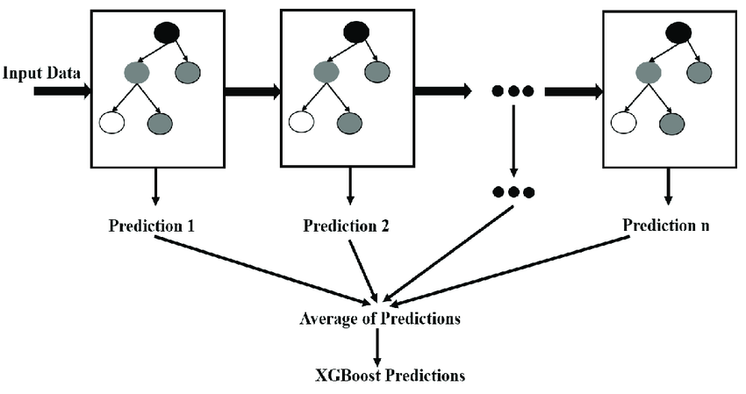
Uses of XGBoost Model
High accuracy
Versatility across structured data problems
Feature importance visualization

Slide 7
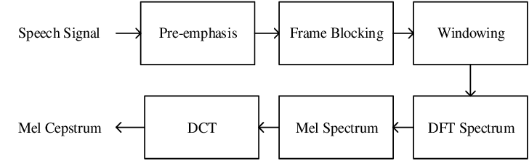
MFCC(Mel-Frequency Cepstral Coefficients)
Feature extraction technique commonly used in audio processing, especially in speech and sound recognition tasks.
Purpose: MFCC represents the short-term power spectrum of sound, capturing its key features in a way that aligns with how humans perceive audio.

Slide 8
Working of MFCC
The audio signal is split into short frames.
Each frame undergoes a Fourier Transform to extract frequency components.
Frequencies are mapped to the Mel scale, which mimics human ear sensitivity.
A log function is applied to represent sound energy.
Finally, a Discrete Cosine Transform (DCT) is applied to decorrelate features and reduce dimensionality.

Slide 9
Real time weather prediction
Loading the Pretrained Model and Scaler
At first we load the pre-trained XGBoost model (weather_predictor_model.json) and scaler (scaler.pkl).
Weather Conditions Mapping
At first a list of possible weather conditions are defined: ["rain", "windy", "hail", "thunder", "snow"].
These are the target labels that the model will predict based on the extracted audio features.
Feature Extraction from Audio
Then using MFCC (Mel-Frequency Cepstral Coefficients) we extracted relevant features from the audio.
Real-time Prediction
By running this process, the system can predict the weather condition in real-time based on audio input captured via a microphone.

Slide 10
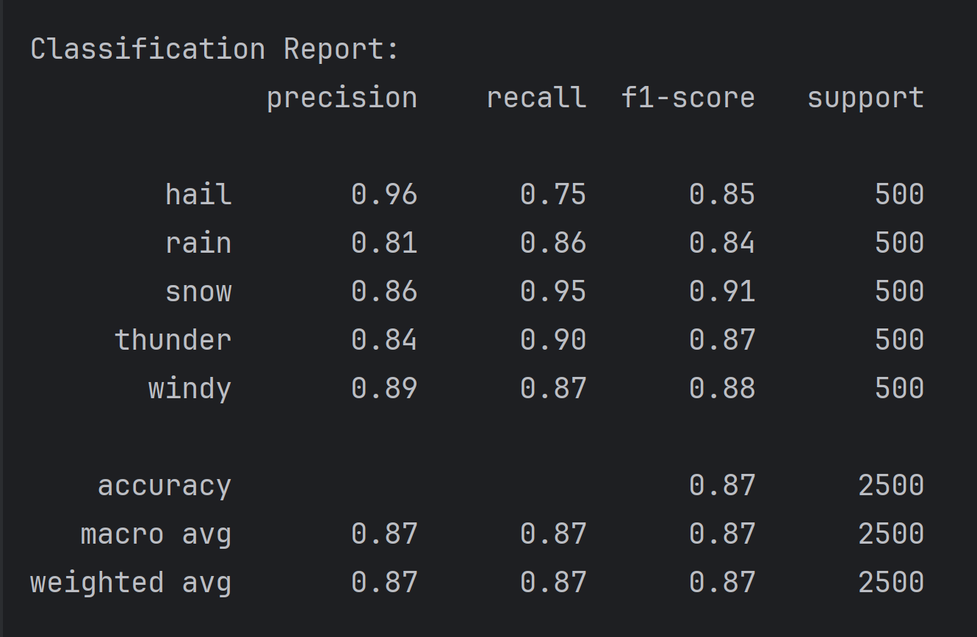
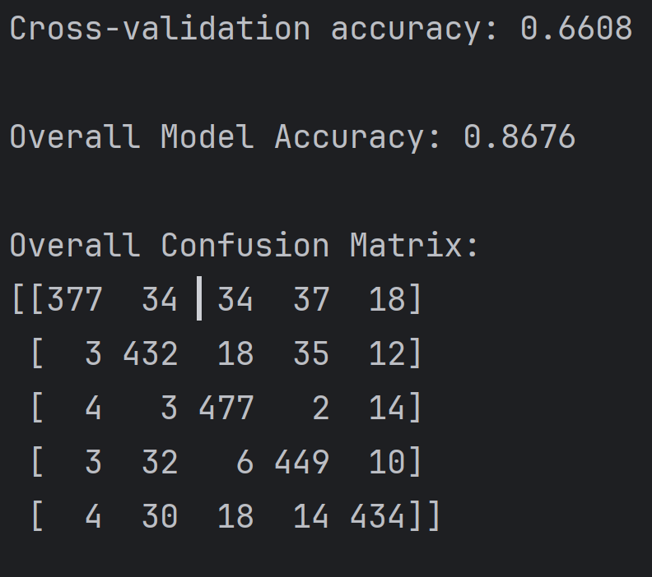
Results of training model

Slide 11
Thanks for listening

